Slide 1














PROJECT 03
GROUP 04

Slide 2




FATINA HAMADI
GUNEL GARAYEVA
HERBERT DENNIS
LINA BLANCO RESTREPO
PROJECT 3 GROUP 4

Slide 3


GLOBAL YOUTUBE STATISTICS 2023
https://www.kaggle.com/datasets/nelgiriyewithana/global-youtube-statistics-2023/data
Top YouTube Channels Statistics:
Detailed data on subscriber counts, video views, upload frequency, and earnings.
Global Reach and Country of Origin:
Insights into the geographic distribution and influence of YouTube's top creators.
Analysis for Aspiring Creators and Data Enthusiasts:
A resource for understanding the dynamics of YouTube success and content creation.

Slide 4
WHY WE CHOOSE THIS DATASET?
We intend to utilize the information including global statistics of the most popular Youtubers. The platform showcases prominent international Youtubers and the corresponding statistics they generate, including their number of subscribers, video views, video categories, and earnings.Youtube is widely used by many folks today, not just for gaming or entertainment purposes.
The primary purpose of the data set is to highlight the achievements of top performers and identify the channels that are most likely to attract more views and subscriptions. This dataset is exclusively intended for the use of YouTubers to monitor the performance of their content creators on a global level, and it has not been adjusted for any other uses. As the team shared their experiences, it became evident that YouTube is also utilized globally for purposes such as teaching, research, and disseminating business information.

Slide 5


QUESTIONS :
01
02
03
WHAT ARE THE TOP 25 YOUTUBE CHANNELS BY THE NUMBER OF SUBSCRIBERS?
WHAT ARE THE TOP 25 YOUTUBE CHANNELS BY COUNTRY?
WHAT ARE THE TOP 10/25 YOUTUBE CHANNELS BY THE NUMBER OF VIEWS?
04
05
06
WHAT CATEGORIES WILL GET THE MOST VIEWS
WHICH CHANNELS HAVE THE HIGHEST TOTAL VIDEO VIEWS?
WHAT ARE THE TOP 10/25 YOUTUBE CHANNELS BY UPLOAD

Slide 6






Growth and Trends
Which channels gained the most subscribers?& What types of content are most popular when looking on categories with the most views and highest engagement
Which channels had the highest video views?
Impact of Education and Unemployment
Is there a correlation between a country's tertiary education
enrollment and the success of YouTube
channels from that country?
How does the unemployment rate
in a country affect the number of YouTube
channels and their success?
MIND
Individual Channel Performance
What is the video upload frequency of a channel, and how does it correlate with its subscriber count?
Earnings Estimates
What are the estimated monthly and yearly earnings for the top YouTube channels?
Country Comparisons
How do YouTube channels from different countries compare in terms of average subscribers and views?
What is the correlation between a country's population and the number of top-ranked YouTube channels it has?
Channel Categories
Which category has the most channels in the top 100 by subscribers?
How do channels in different categories compare in terms of average views and earnings, by country?

Slide 7
Geographic Insights
What is the distribution of top YouTube channels by geographic coordinates (latitude and longitude)?
How does urban population percentage relate to the number of successful YouTube channels in a country? (TBA)
MIND... CONTINUATION
Historical Trends
What are the oldest YouTube channels in the top 100 by subscribers?
How does the creation year of a channel relate to its current subscriber count and viewership?
Country-Specific Rankings
Which country has the most YouTube channels in the top 100 globally?

Slide 8
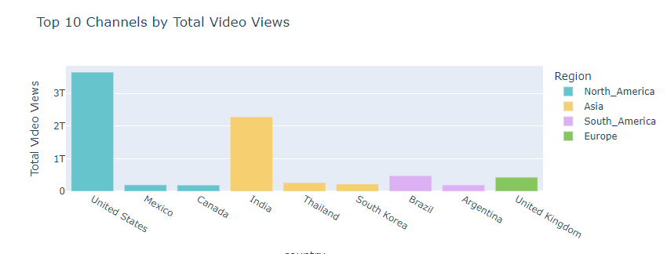
GROWTH AND TRENDS
Channels with the most Subscribers and Views

Slide 9
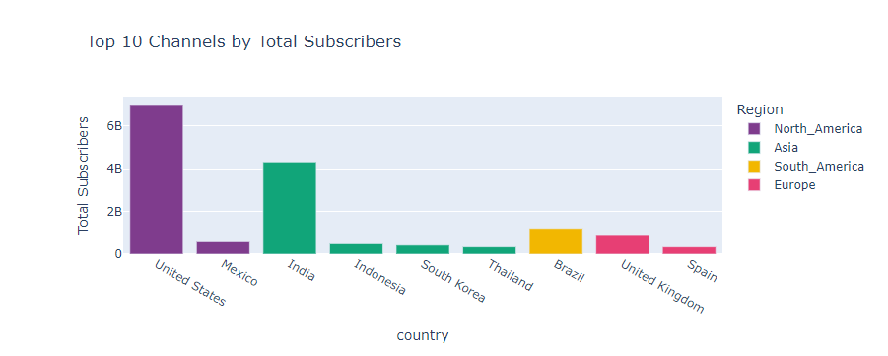
GROWTH AND TRENDS
Channels with the most Subscribers and Views

Slide 10
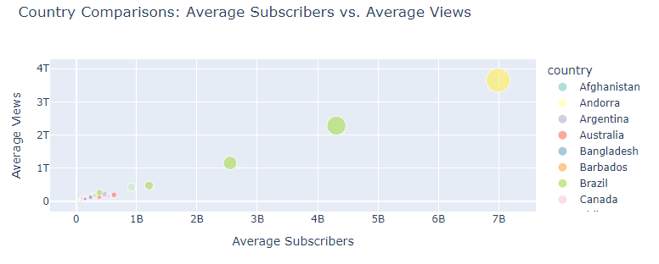
COUNTRY COMPARISONS
When comparing channels in different countries for average subscribers and views?

Slide 11
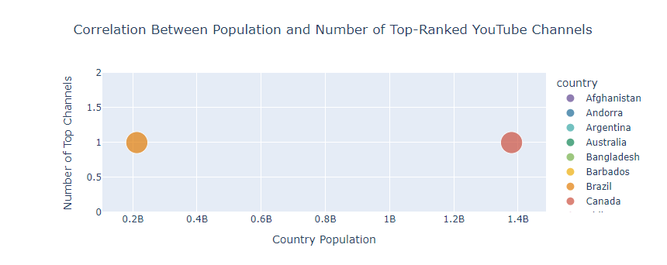
COUNTRY COMPARISONS
What is the correlation between a country's population and the number of top-ranked YouTube channels

Slide 12
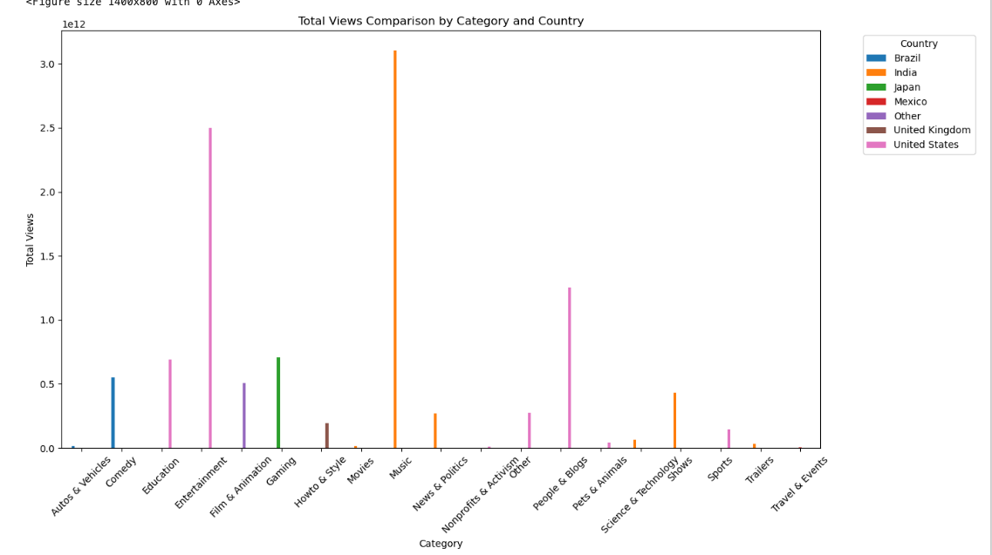
CATEGORIES VS VIDEO VIEWS
1.Music | 2. Entertainment | 3. People & Blogs | 4. Education | 4. Gaming | 5. Comedy

Slide 13
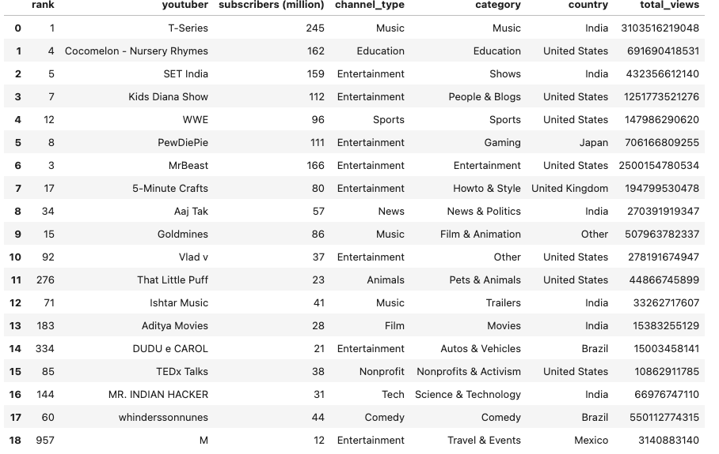
CATEGORIES VS VIDEO VIEWS

Slide 14
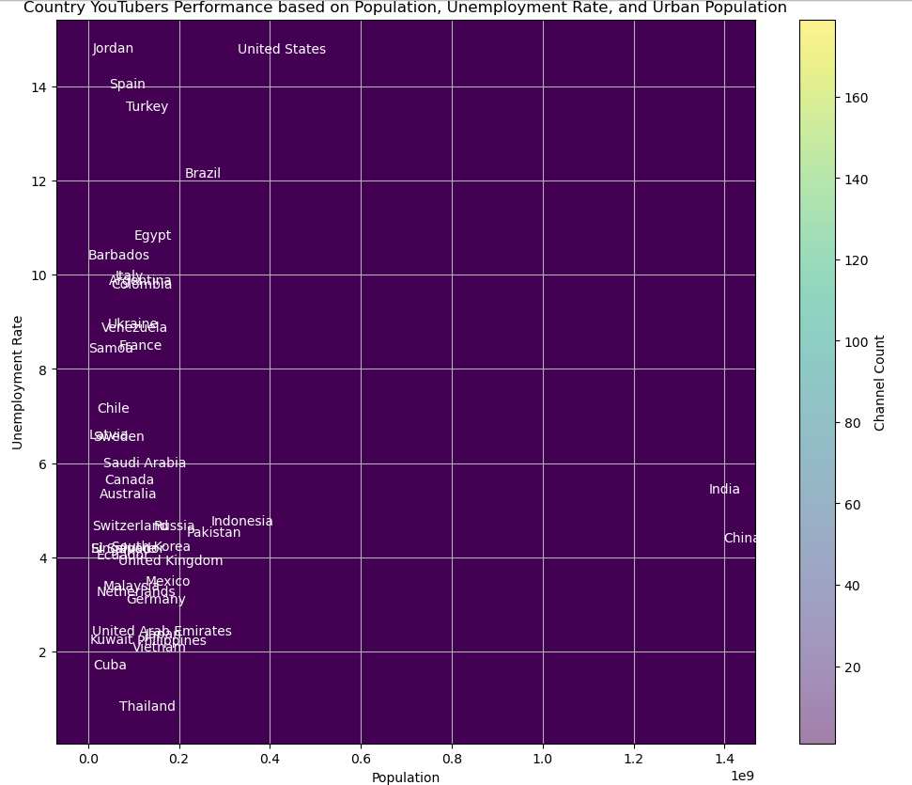
POPULATION
Unemployment
Population
Urban Population

Slide 15
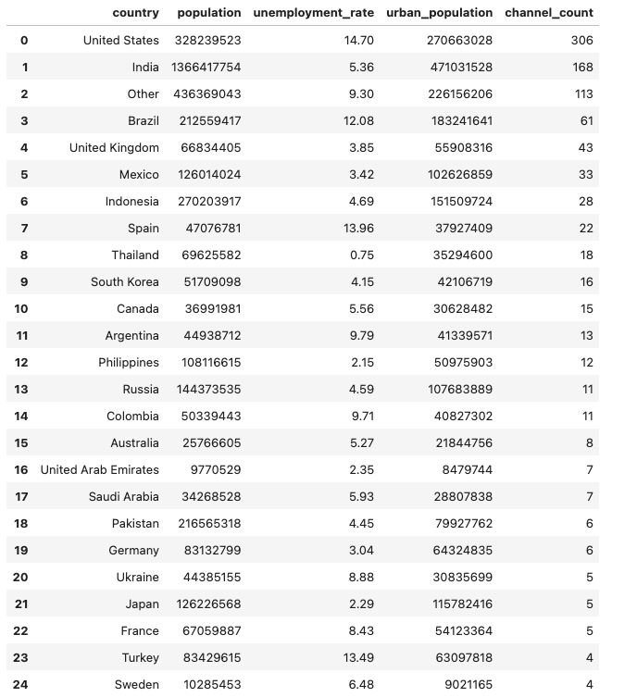
DEMOGRAPHICS
VS CHANNEL COUNT
Unemployment
Population
Urban Population

Slide 16
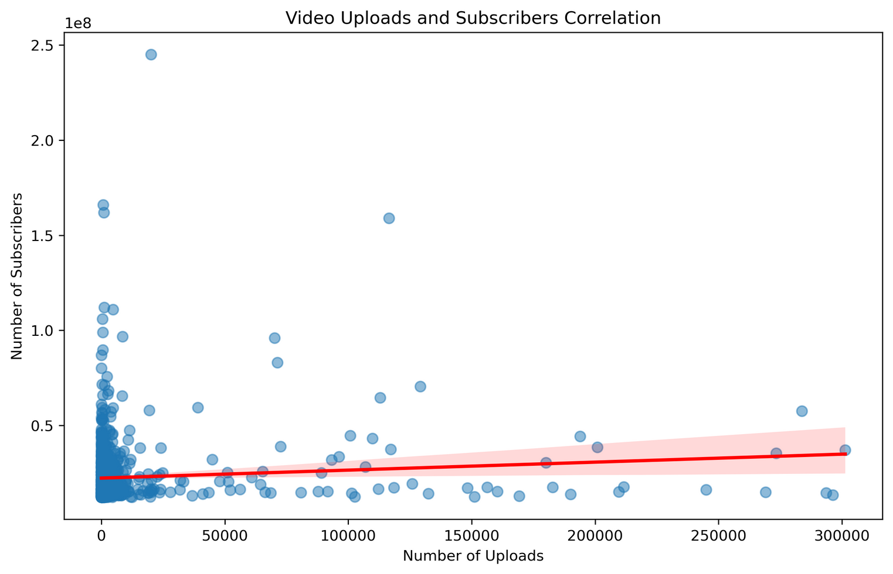
CORRELATION OF VIDEO UPLOADS AND SUBSCRIBERS
The graph indicates that even if a channel has a high number of uploads, it does not necessarily equal a high subscriber count.

Slide 17
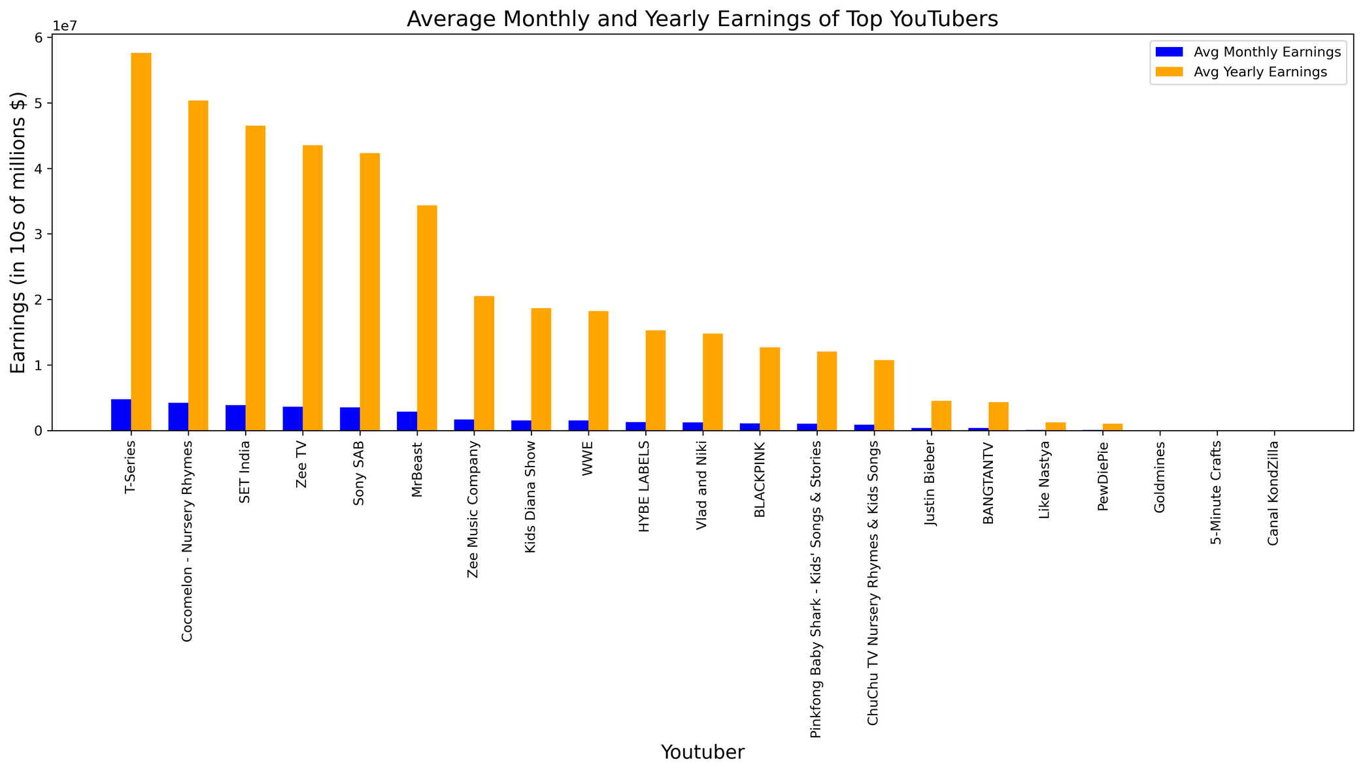
EARNINGS OF TOP YOUTUBERS
The graph shows how lucrative successful YouTube channels can be with top channels generating income in the millions on a monthly basis and in the 10s of millions on a yearly basis.

Slide 18
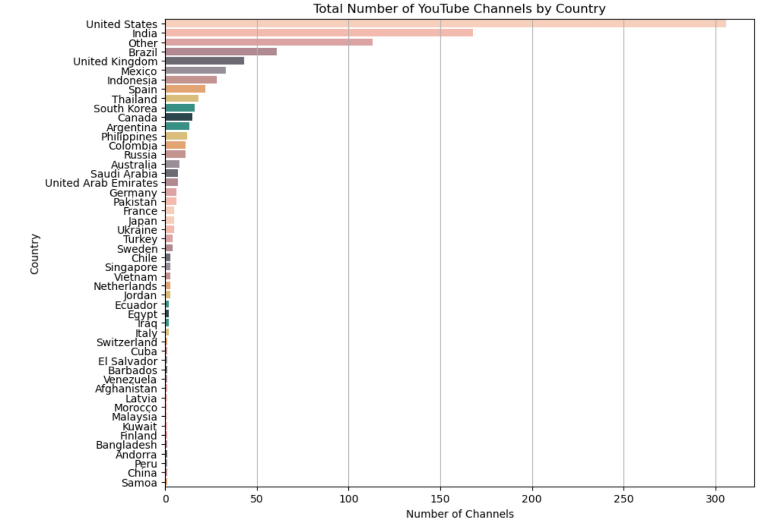
TOP NUMBER OF YOUTUBE CHANNELS BY COUNTRY
LOOKING AT THE TOP CHANNELS BY COUNTRY, INDIA AND THE UNITED STATES LEAD THE PACK BY A LARGE MARGIN. OTHER COUNTRIES WITH A STRONG PRESENCE INCLUDE BRAZIL, THE UK, AND MEXICO IN THE TOP 5.

Slide 19
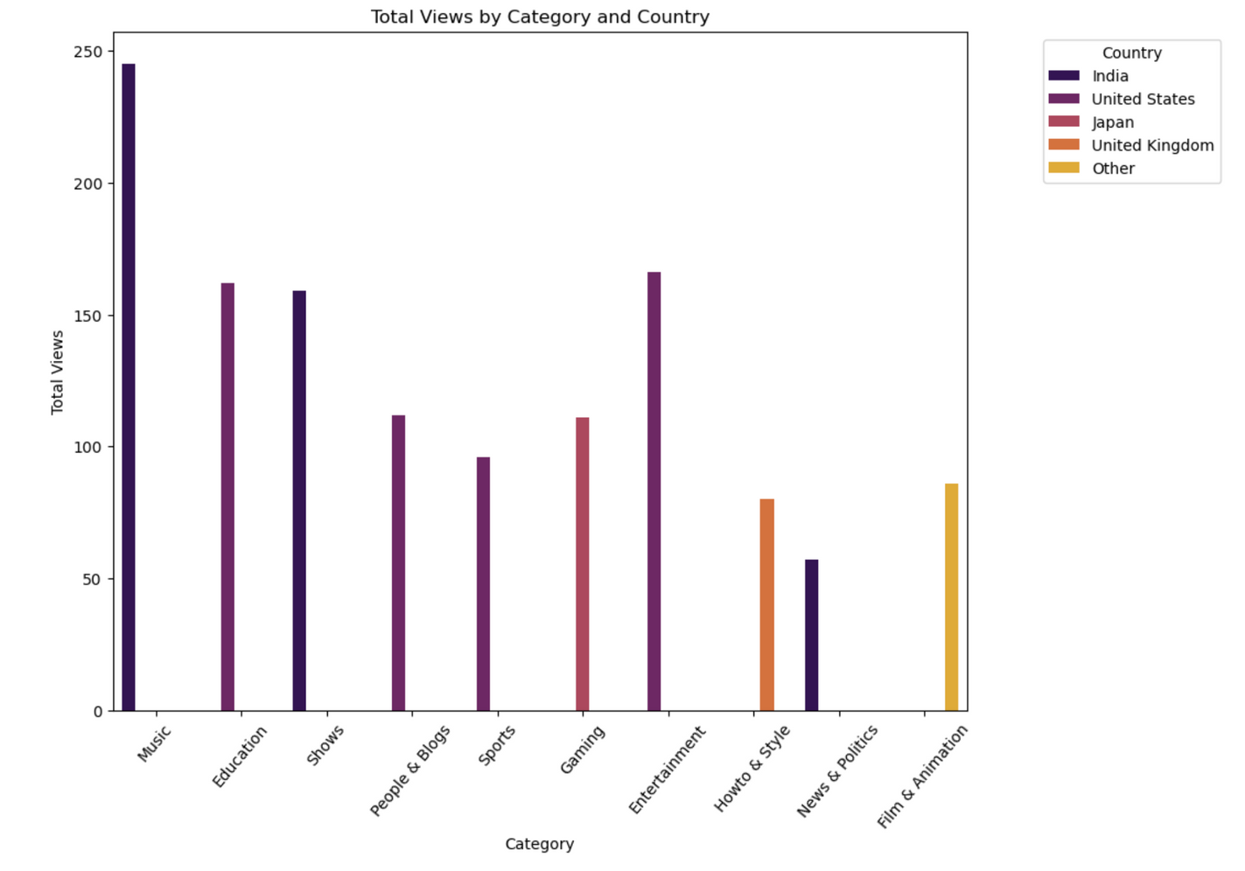
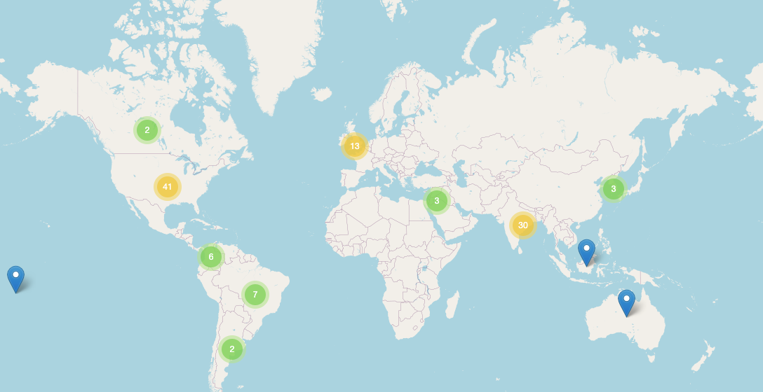
THE LEADERS ON TODAY’S YOUTUBE ARE CENTERED AROUND MUSIC AND ENTERTAINMENT.MUSIC IS THE LARGEST CATEGORY, MAKING UP OVER 28% OF THE TOP CHANNELS. ENTERTAINMENT CHANNELS HAVE THE NEXT BIGGEST PRESENCE. INDIA AND THE U.S. ARE HOME TO THE MAJORITY OF TOP CHANNELS.

Slide 20
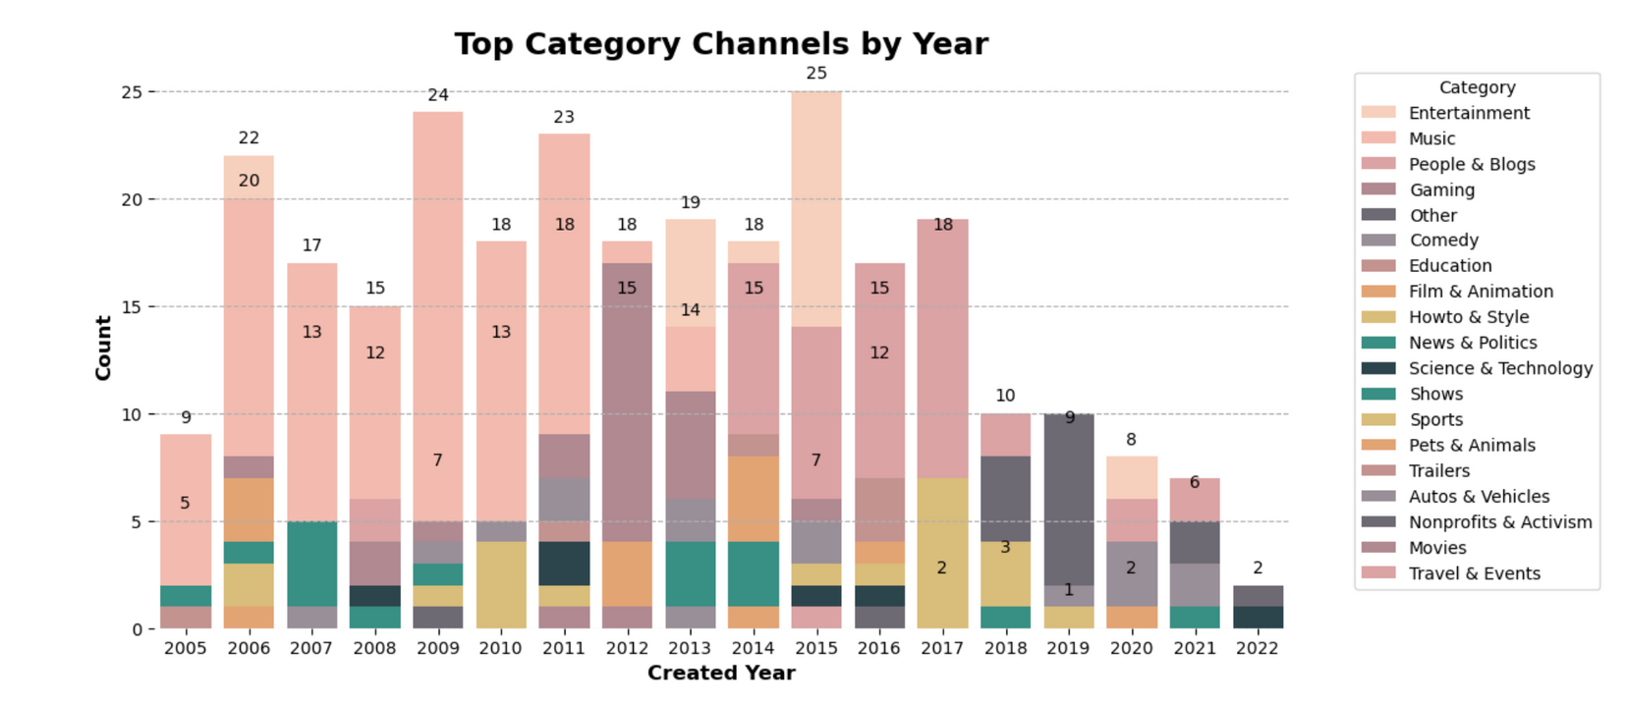
TOP CATEGORY CHANNELS BY YEAR

Slide 21
BIASES AND LIMITATIONS
Biases
The information from the dataset includes only the top YouTubers and channels and does not display a full representation of the whole YouTube community and platform.
The dataset is only for the year 2023 and does not capture channels that may have once been popular, but have since declined in the various data points discussed that were directly related to the channels.
Country representation is skewed with countries like the US and India dominating the top channels, but there are popular channels in smaller countries that were not represented on the list.
Limitations
The original dataset had a significant number of “nan” values that could not be simply be replaced and rows had to be dropped.
The data is public and we noticed certain values for some countries such as employment rate were incorrect for the year of 2023.
The data is limited to only country location and nothing specific such as state or department and city.
The income of a YouTube channel does not solely come from the activity of the channel, but can also come from sponsorships, in video ads, and referral links for products and services.

Slide 22
REFERENCES & SOURCES
Global YouTube Statistics 2023
Nidula Elgiriyewithana
https://www.kaggle.com/datasets/nelgiriyewithana/global-youtube-statistics-2023/data

Slide 23
THANK YOU VERY MUCH!

